Slide 1
Road Safe Phone Case:
Project Plan
Members: Ali Almadami, Isaac Kosgey, Philip Markose, Shuang Li, Shihab Al Balushi, Chad Korby
Client: Christine Shea-Hunt
Notes:
This is Philip Markose with an overview of the Project Plan. Our product, which started as a phone case, has revolutionized to an On board diagnostics scanner that emits a signal to the drivers phone. To share more details are Ali Almadami, Isaac Kosgey, Shuang Li, Shihab Al Balushi, and Chad Korby.

Slide 2
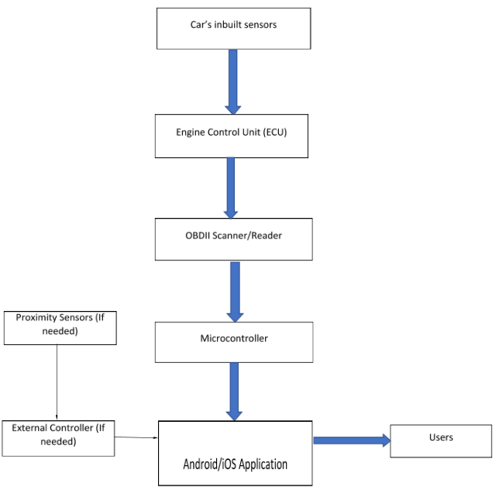
Hardware: Block Diagram
Car’s inbuilt sensors
Engine Control Unit (ECU)
OBDII Scanner/Reader
Microcontroller
Android/iOS Application
Users

Slide 3
Hardware: OBD-II Computing
OBD-II
Used in all cars since 1996
Real-time data and fault diagnostics
Microcontroller - Raspberry Pi
Programmed in Python
Gear detection
Potential PCB board
PiCAN2
Made to use with Raspberry Pi
Connects directly to Raspberry Pi pins
OBD-II to USB
Externally manufactured by company
Ease of use

Slide 4
Hardware to Software
Microcontroller - Raspberry Pi
Has a built in Bluetooth that connect to the backend portion of the Softwear.
Bluetooth library in the Raspberry Pi.
Bluetooth protocol to connect to Firebase.

Slide 5
Software Backend - Firebase
Backend Platform:
Integrate Firebase into frontend development
User Registration and Authentication:
Firebase Authentication
Database:
Firebase Realtime Database
Data structure stored in database
BasicInfo:
{
UID1: {
Name:
Usertype: 0 - Child
ChildIDs: {}
}
UID2: {
Name:
Usertype: 1 - Parent
ChildIDs: {}
}
…
}
ViolationHistory:
{
UID1: {
1: {
Time:
Location:
WhatHappened:
...
}
2: {
...
}
...
}

Slide 6
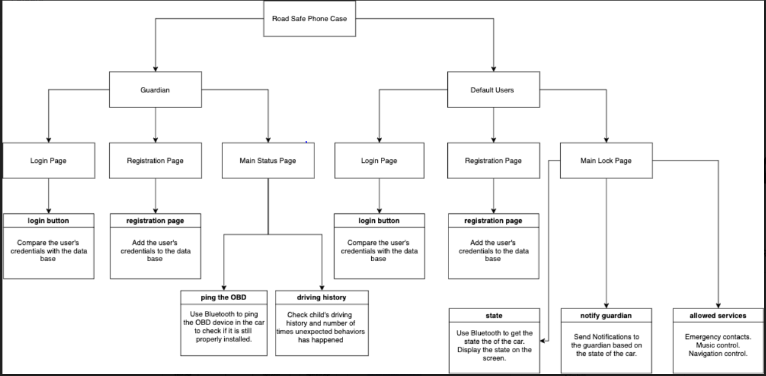
Software Frontend

