Slide 1
Road Safe Phone Case:
Technical Challenges - Bluetooth
Members: Ali Almadani, Isaac Kosgey, Philip Markose, Shuang Li, Shihab Al Balushi, Chad Korby
Client: Christine Shea-Hunt

Slide 2
Hardware: Problems
PiCAN2
Provides CAN-bus capability for the Raspberry Pi
OBD II
Real time data and fault diagnostics from the ECU
Microcontroller - Raspberry Pi
Programming in Python
Deciphering data from the OBD II

Slide 3
Hardware: Solution
OBD-II
Used in all cars since 1996
Real-time data and fault diagnostics
Microcontroller - Raspberry Pi
Programmed in Python
Gear detection
Potential PCB board
PiCAN2
Made to use with Raspberry Pi
Connects directly to Raspberry Pi pins
OBD-II to USB
Externally manufactured by company
Ease of use

Slide 4
Software: Problem
Allow the app to continuously receive data from microcontroller through bluetooth
Allow user to select which device the app will be paired with
Reading data continuously from bluetooth
Maintain connection while within range
Once the app has been paired with the microcontroller once, save the paired device’s configuration locally so that next time the microcontroller’s bluetooth is connected to the phone, the app will automatically start reading data
Notes:
Hi this is Shuang and I am going to talk about the software side of the technical challenge we face with bluetooth connection. Most of the functions in this project, such as detecting whether teenager is driving or allow parent to check whether the device installed is still functioning correctly, depend on the connection between our hardware and software. Specifically on the software side, the main task is to -
(For Shuang’s reference only: another function in the UI would be to allow user to update their hardware and re-configure the pairing with hardware)

Slide 5
Software: Solution
To solve our software problem we found libraries for the different platforms that we plan to develop our app on:
IOS Bluetooth APIs, for the IOS platform.
Android Bluetooth APIs, for the Android platform.

Slide 6
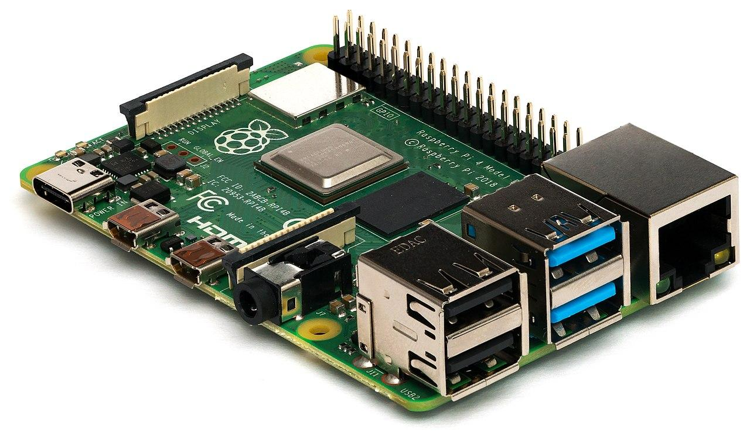
Other Technical Issues
OBD-II Scanner
Bluetooth
Button: Turn on bluetooth discovery
Battery: Power RPi after Car is off
Notes:
While Bluetooth may be our largest challenge, we still have others. The is Philip Markose and I will be highlighting our other technical issues. With the ETG closed, we were unable to access a PiCan. This issue was resolved. The next issue is having our app limit phone accessibility. The team also came up with new ideas for hardware. Our hardware will need an external button that turns on the Pi’s bluetooth discovery mode. Finally, the device shouldn’t die when the engine is turned off. These are a couple of other technical issues the team is facing.

